Slide 1
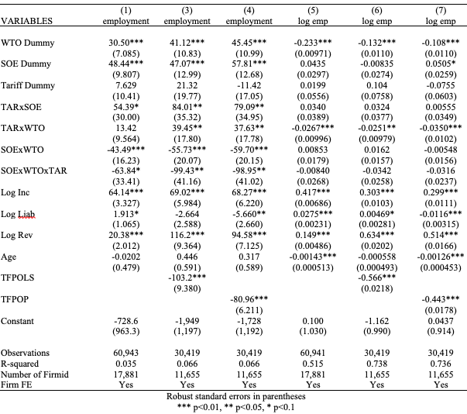
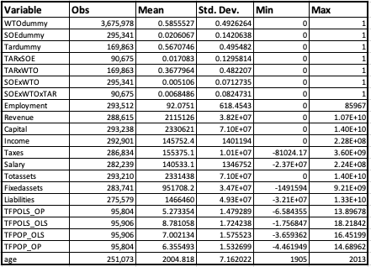
Power of the Policy Burden: Empirical Evidence on Employment after Trade Liberalization for State Owned Enterprises in Vietnam
REPLACE THIS BOX WITH YOUR ORGANIZATION’S
HIGH RESOLUTION LOGO
Jack Pierre, Class of 2021
Professor Alicia Dang, Department of Economics
Introduction into SOEs / Goal
Research Question and Hypothesis
Data Sources and Analysis
Around the world, State-Owned Enterprises (SOEs) continue to serve important purposes in many economies
Some of the fastest growing economies such as China, Vietnam, or South Korea have used SOEs to drive recent economic growth
SOEs are used by many countries around the world for policy burdens, which vary from profit maximization
When might a state-owned enterprise’s policy burden be a beneficial?
In the event of trade liberalization, there would be a significant negative effect in employment on companies that now have to deal with increased competition from foreign firms. Because SOEs have a policy burden to employ, a soft budget constraint, and are favored by government policies, they will decrease employment less than a privatized company would. The opposite would apply with gains of trade as SOEs would not get to gain as much from trade as a private company would
Data used for analysis was gathered from:
The Vietnam Enterprise Survey from the World Bank Microdata Library for years 2000 – 2014. This contains firm level data for all enterprises larger than 10 employees and a sample of those with less than 10 employees
Data on Tariffs for Vietnam was given every other year from the World Bank’s World Integrated Trade Solution(WITS) Database
Total Factor Productivity was calculated using both Olley-Pakes two step estimation and an OLS Fixed Effects estimation and performed using two different methods
Advantages and Disadvantages of a Policy Burden
To accomplish their policy burdens, SOEs are given certain benefits:
SOE’s typically have better access to industrial subsidies and tax holidays
SOE’s have better credit that allows them preferential access to loans and lower interest rates than private enterprises (PE’s)
SOE’s use a soft budget constraint which can allow the organization to sustain losses because the government will fit the bill
However, many of these benefits have negative consequences on the firm:
By attempting to achieve a goal other than profit maximization, it becomes difficult to evaluate managers and determine causes of inefficacy
SOEs typically perform worse than private enterprises in terms of typical financial performance measures, such as return on investment
The soft budget constraint means that poor performance is paid for by taxpayers or the federal or state governments
Allocating Industrial subsides to firms that do not return as much on investment is a misallocation of resources
Prone to corruption and other forms of mismanagement
Figure 1. Average Revenue for a Firm by Ownership
Figure 2. Average Employees per Firm by Ownership
Figure 3: Average Tariff for all industries by year
Results
Model and Equation
This analysis will utilize a difference in difference in difference model which uses dummy variables and interaction terms to measure the effects of Vietnam’s 2007 WTO entrance on State-Owned Enterprises. This allows analysis to be performed on the effect that inherent differences between two groups using dummy variables and interaction terms between them. Thus, the equation is as follows:
${Employment}_{it}=β_{0}+β_{1}∗{WTO}_{i}+β_{2}∗{SOE}_{i}+β_{3}∗{TAR}_{it}$+ $β_{3}∗{TAR}_{it}$* ${SOE}_{i}$+ $β_{3}∗{TAR}_{it}$* ${WTO}_{t}$+ $β_{3}∗{TAR}_{it}$* ${SOE}_{i}+$ $β_{3}∗{TAR}_{it}$* ${SOE}_{i}∗{WTO}_{t}+ β_{1}∗X_{it}+ε_{it}$
where WTO is a dummy for the year 2007, TAR is a dummy for firms that experience a large change in tariffs after 2007, SOE is a dummy for state ownership, and X is the variables that capture firm level fixed effects (i) across years (t).
Table 1. Descriptive Statistics
Discussion
State ownership in Vietnam has a positive and significant effect on a firm’s employment
After entrance in the WTO, many SOEs saw a decline in employment, especially in tariff affected industries
This might be a result of SOE reforms set in place by the government that consolidated many SOEs into SOE groups. This caused many SOE’s to close doors
PE’s increased employment after entrance to the WTO, especially those in industries that decreased tariffs significantly.
Industries with affected-tariffs did not have higher employment until after 2007.
Contact Information
References
Acknowledgements
Jack Pierre
Class of 2021
pierrej@union.edu
8474715612
Abramov, Alexander, Alexander Radygin, Revold Entov, and Maria Chenova. “State Ownership and Efficiency Characteristics.” Russian journal of economics (Moskva) 3, no. 2 (June 2017): 129–157, https://doi.org/10.1016/j.ruje.2017.06.002.
Angrist, Joshua David, and Jörn-Steffen Pischke. Mostly Harmless Econometrics: an Empiricist's Companion. Economics Books, Princeton University Press, edition 1. 2009.
Aghion, Philippe, et al. “Industrial Policy and Competition.” American Economic Journal. Macroeconomics, vol. 7, no. 4, American Economic Association, 2015, pp. 1–32, doi:10.1257/mac.2012010
Baccini, Leonardo, Giammario Impullitti, and Edmund J Malesky. “Globalization and State Capitalism: Assessing Vietnam’s Accession to the WTO.” Journal of international economics 119 (July 2019): 75–92.
Baum, Anja, Clay Hackney, Paulo Medas, and Mouhamadou Sy. “Governance and State-Owned Enterprises: How Costly is Corruption?” International Monetary Fund, IMF Working Paper 19/253, 2019.
Chipman, John S. “Factor Price Equalization and Stolper Samuelson Theorem.” International Economic Review, vol. 10, no. 3 (Oct, 1969), 399-406.
Cull, Robert, and Lixin Colin Xu. “Who Gets Credit? The Behavior of Bureaucrats and State Banks in Allocating Credit to Chinese State-Owned Enterprises.” Journal of Development Economics, vol. 71, no. 2, Elsevier BV, (2003), pp. 533–59, doi:10.1016/s0304-3878(03)00039-7.
Duanmu Jing‐Lin, and Russell Pittman “THE RESPONSE OF STATE‐OWNED ENTERPRISES TO IMPORT COMPETITION: EVIDENCE FROM CHINESE MANUFACTURING FIRMS.” Annals of public and cooperative economics 90, no. 4 (May 6, 2019): 577–613.
Deng, Yongheng, Randall Morck, Jing Wu, and Bernard Yeung. "Monetary and Fiscal Stimuli, Ownership Structure, and China's Housing Market," NBER Working Papers 16871, National Bureau of Economic Research, Inc. 2011.
Harrison, Ann, Marshall Meyer, Peichun Wang, Linda Zhao, and Minyuan Zhao. “Can a Tiger Change Its Stripes? Reform of Chinese State-Owned Enterprises in the Penumbra of the State.” National Bureau of Economic Research, NBER Working Paper 25475, January 1, 2019.
Hsieh, Chang-Tai and Peter J. Klenow. “Misallocation and Manufacturing TFP in China and India.” The Quarterly journal of economics 124, no. 4 (November 2009): 1403–1448.
Ka Yin Chan, Kenny, Li Chen, & Norman Wong. “New Zealand State-owned enterprises: is state-ownership detrimental to firm performance?” New Zealand Economic Papers, 52, no 2 (2018): 170-184.
Lin, Justin Yifu, and Zhiyun Li. “Policy Burden, Privatization and Soft Budget Constraint.” Journal of Comparative Economics 36, no. 1 (2008): 90–102.
Lin, Justin Yifu, Fang Cai, and Zhou Li. “Competition, Policy Burdens, and State Owned Enterprise Reform” The American Economic Review 88, no. 2 (May, 1998), 422-427
Leung, Suiwah. “The Vietnamese Economy: Seven Years after the Global Financial Crisis.” Journal Of Southeast Asian Economies 32, no. 1 (2015). 1-10.
Rajib, Salah Uddin, Emil Sudath Kumara, and Luo Fan. “Investigating the Failure of State Owned Enterprises (SOEs) of an Emerging Economy: A Comparative Case Study.” Studies in Business and Economics, vol. 11, no. 2, De Gruyter Open, Aug. 2016, pp. 115–29, doi:10.1515/sbe-2016-0026.
Samaniego, Roberto M. “Industrial subsidies and technology adoption in general equilibrium” Journal of Economic Dynamics and Control, 30 (2006):1589-1614.
Shleifer, Andrei. "State versus Private Ownership." Journal of Economic Perspectives, 12, no. 4 (Fall 1998): 133-150.
Stiglitz, Joseph E.“Theories of Wage Rigidity” National Bureau for Economic Research, NBER Working Paper No. 1442, 1984.
Sturesson, Jan, Scott McIntyre, and Nick C. Jones. “State Owned Enterprises: Catalysts for public value creation.” PricewaterhouseCoopers. 2015. https://www.pwc.com/gx/en/psrc/publications/assets/pwc-state-owned-enterprise-psrc.pdf
Tõnurist, Piret, and Erkki Karo. “STATE OWNED ENTERPRISES AS INSTRUMENTS OF INNOVATION POLICY.” Annals of Public and Cooperative Economics, vol. 87, no. 4, Wiley, 2016, pp. 623–48, doi:10.1111/apce.12126.
Tran Thai Ha, Nguyen and Phan Gian Queyen. 2017. “The relationship between state ownership and tax avoidance level: empirical evidence from Vietnamese firm” Journal of Asian Business Strategy, vol 7, no. 1, 1-12.
Wacker, Konstantin M. “Restructuring the SOE Sector in Vietnam.” Journal of Southeast Asian economies 34, no. 2 (August 1, 2017): 283–301.
Wen, Yi, and Jing Wu. “Withstanding the Great Recession Like China: Withstanding the Great Recession.” The Manchester School 87, no. 2 (March 2019): 138–182.
Qian, Yingyi. “Enterprise reform in China: agency problems and political control.” Economics of Transition, Volume 4, no 2 (1996), 427-447.
Yu, Shungwon, and Namryoung Lee. “Financial Crisis, Politically Connected CEOs, and the Performance of State-Owned Enterprises: Evidence from Korea.” Emerging Markets Finance and Trade, vol. 52, no. 9, Routledge, Sept. 2016, pp. 2087–99, doi:10.1080/1540496X.2016.1186445.
I’d like to thank my thesis advisor, Professor Dang, for the immeasurable amount of help that she provided to me throughout this whole process. I would also like to thank the many people who gave me input on my writing and ideas throughout the process

