Slide 1
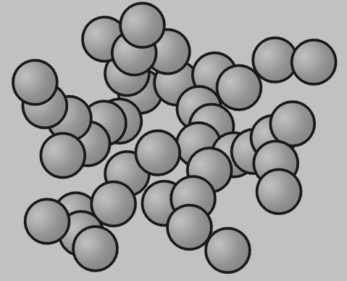
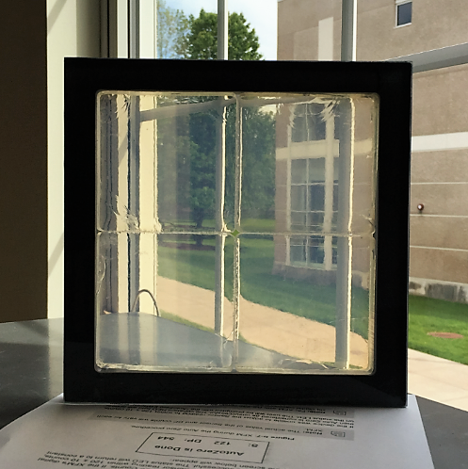
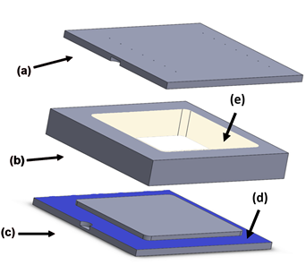
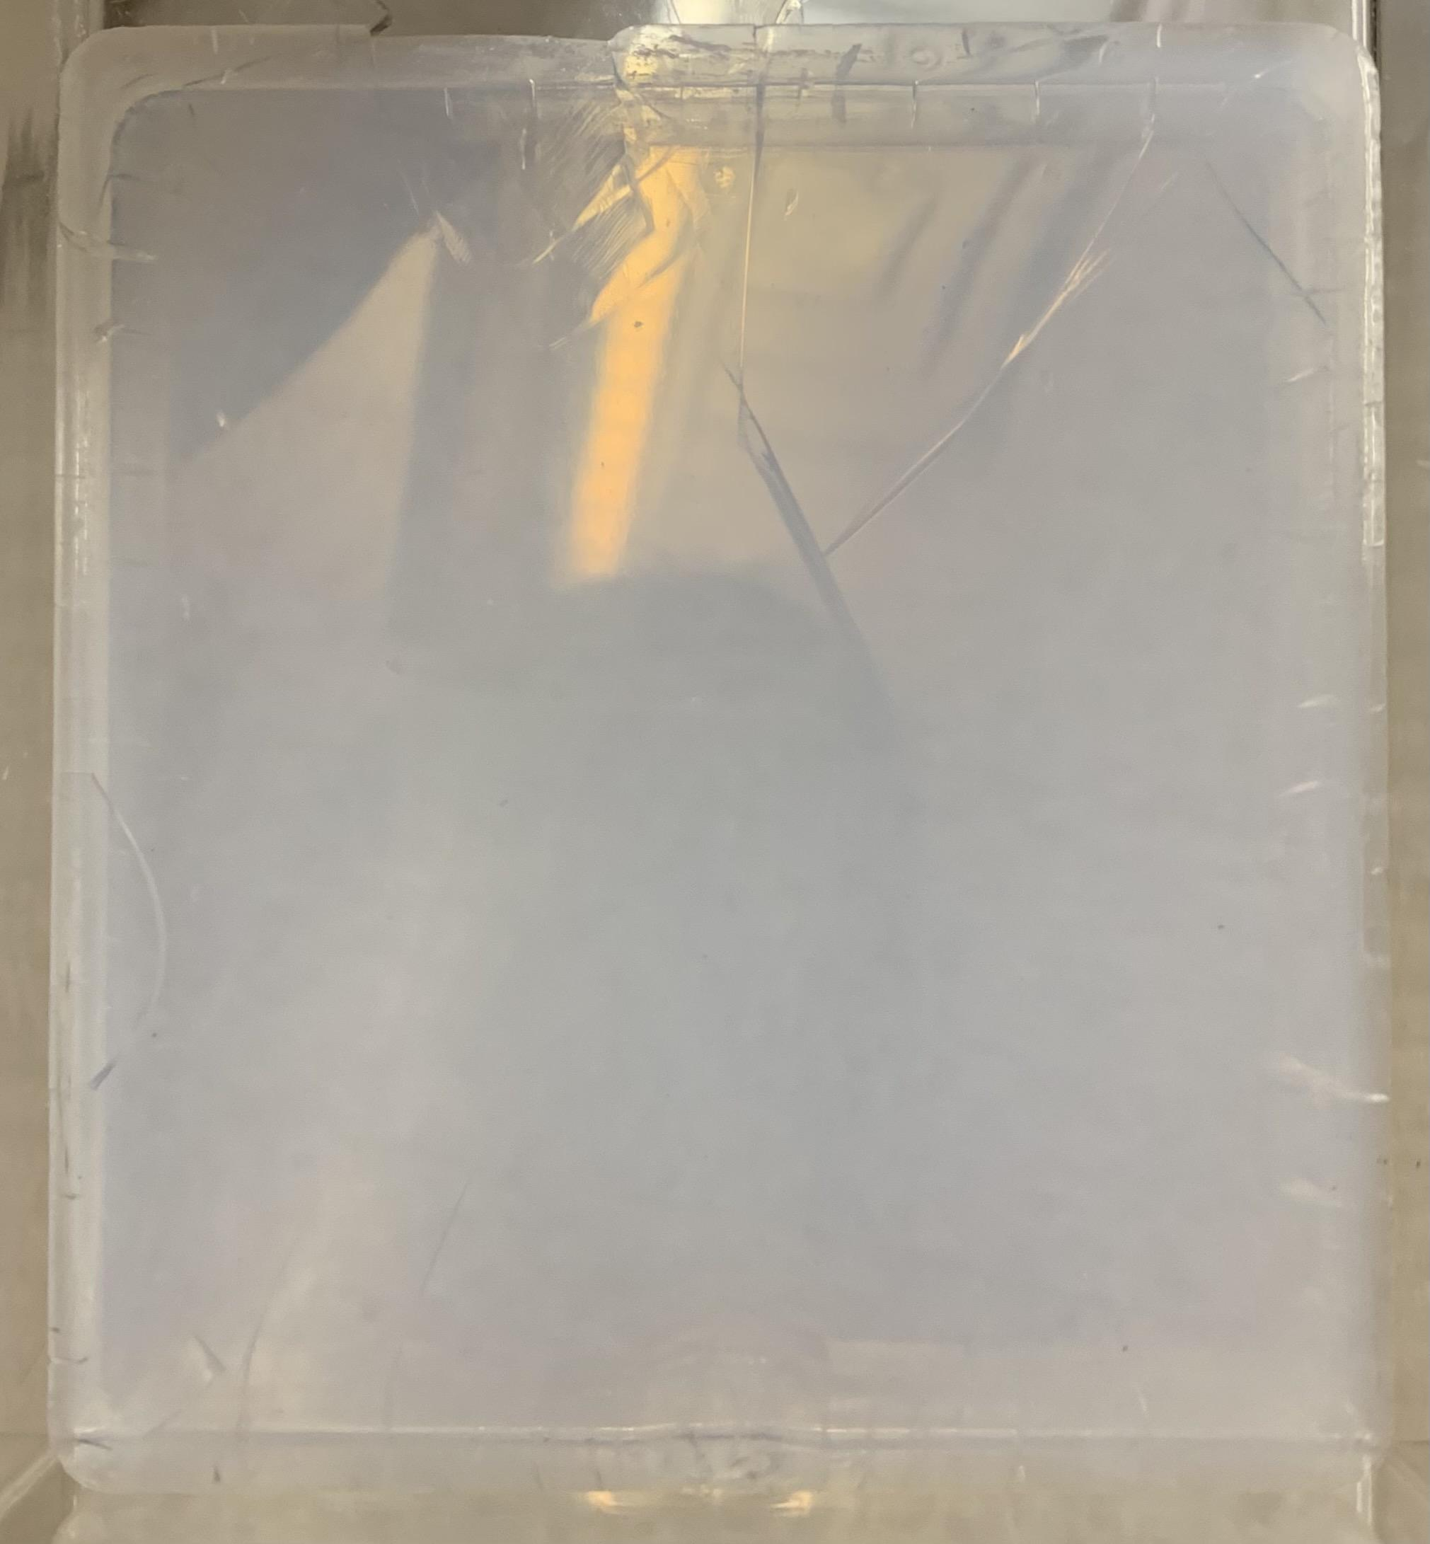
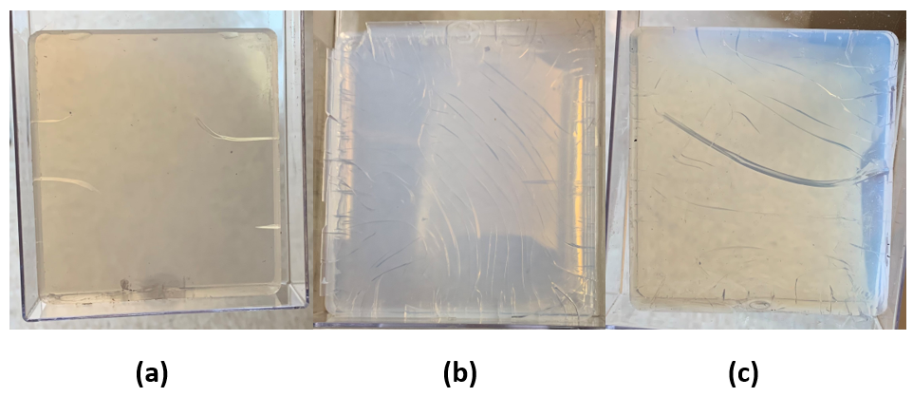
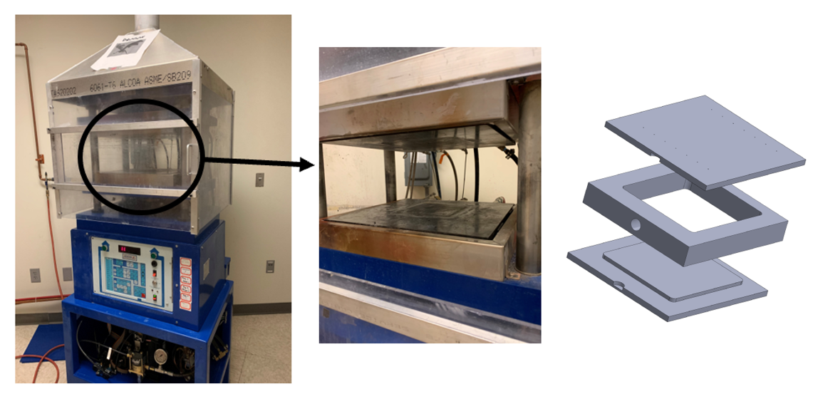
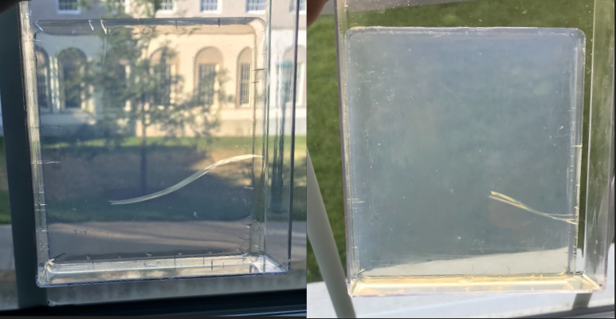
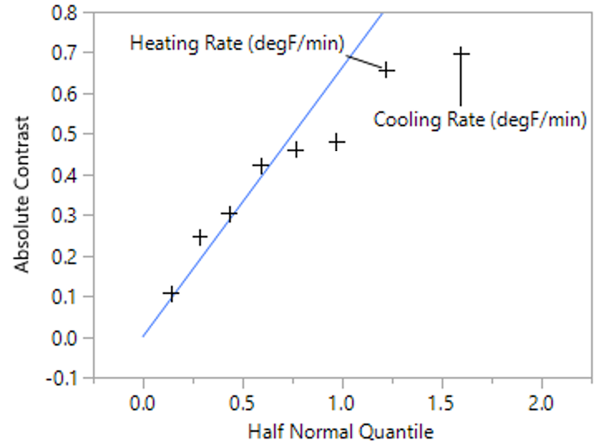
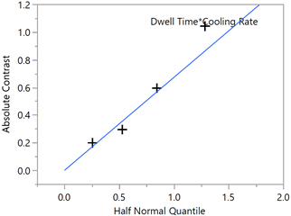
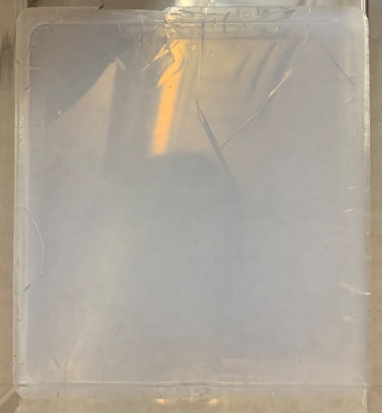
A Statistical Design of Experiments: Analysis of the Aerogel Production Process
Allison M. Stanec, Ann M. Anderson
Department of Mechanical Engineering,
Union College, Schenectady NY
/
muse.union.edu/aerogels
Project Objective and Goals
Aerogel Fabrication
Conclusions
Silica aerogel monoliths are difficult to produce with no imperfections, i.e., cracking and chipping. In order to make a monolithic aerogel, a supercritical extraction is needed. Research has been conducted in the past to determine the best parameters that will minimize the stresses induced in the aerogels, thus minimizing the cracking. Many studies have looked into the factors that cause cracking in aerogel monoliths. At Union College, we make aerogels using the patented Rapid Supercritical Extraction (RSCE) method and can produce silica aerogel monoliths, 10 cm x 11 cm x 1.5 cm, in approximately 10 hours [2]. However, we have had difficulty producing crack free aerogels as we have approximately a 50% success rate. The goal of this project was to set up a two-level Plackett Burman screening design to statistically determine the most important factors in the production process. This will allow us to produce aerogel windows with larger, crack-free, monolithic samples.
Mold Design: Three-part mold consisting of a top, middle, and bottom portion, (Fig 3). There is the connecting surface on the bottom mold with an identical surface on the top mold, (Fig 3d). Surfaces that come in contact with the aerogel are the raised portion of the bottom mold, with an identical surface on the top mold and the inside surface of the middle mold, (Fig 3e).
Mold Preparation: The mold is cleaned using soap and acetone. It is sanded with a 1500 grit sandpaper. A thick layer of grease is applied to the connecting surfaces of the top and bottom mold, and a thin layer of grease is applied to the surfaces that come in contact with the aerogel.
Recipe: 41.30 g tetramethyl orthosilicate (TMOS), 103.33 g methanol (MeOH), 17.04 g deionized water (H₂O), 1.27 mL 1.5 M ammonia (NH₃).
From the first screening we learned:
The two most important factors were the heating and cooling rate. They were not statistically significant, but still were significant factors.
Faster cooling rate and slower heating rate is ideal
From the second screening we learned:
A cooling rate of 30 °F/min is ideal
The most important factor is the interaction between the cooling rate and dwell time.
At a low cooling rate of 30 °F/min, increasing the dwell time will have the largest effect on the quality of the aerogel.
At any higher cooling rate, increasing the dwell time will have little effect on the quality of the aerogel
Using the following parameters, the highest quality aerogel, Fig. 8, can be made (based on the best aerogel produced in the 2nd trial of the second screening), Table 4.
New production time: ~ 6 hrs (40% reduction)
Figure 3: Three-part mold consisting of a (a) top, (b) middle, and (c) bottom portion.
Hot Press Parameters via RSCE: The mold is sealed with a 55-kip force for 30 min at 90 °F. The mold is then heated at a rate of 2 °F/min to a supercritical temperature of 550 °F. The solution is let to stabilize and strengthen for 55 min. Supercritical fluid is released as the force is released at a rate of 1 kip/min. The mold is then cooled back down to 90 °F at a rate of 2 °F/min. Note: these factors are a base set of parameters. Parameters/settings are adjusted in each screening design.
Background
First Screening Design
Table 4: Set factors based on the conclusions that were drawn from the first two screening designs.
Silica aerogels are a nanoporous material and consist of 90-99% air. They have many unique properties such as a low density, low thermal and electrical conductivity, and large surface area. Due to these properties they can be used in a wide range of applications such as in acoustic devices [3] and in walls and windows as a form of insulation [4].
Producing a monolithic aerogel is difficult as it requires a supercritical extraction method. At Union, we use the RSCE method using a hydraulic hot press and steel mold, (Fig 1). We have made 10 cm x 11 cm x 1.5 cm silica aerogels in approximately 10 hrs; however, we have had problems with the aerogels cracking, (Fig 2).
Based on previous research conducted to understand the cracking in silica aerogels, these are a set of important factors that can be statistically analyzed using a DOE to determine which ones are the most significant.
List of Important Factors in the Production Process
Catalyst: silica network needs to form in the supercritical state which is controlled by the amount of catalyst used [5].
Heating rate: the heating rate cannot be too fast as stretches would be produced in the gel network while a slow heating rate allows liquid to escape from the gel [6].
Depressurization: like in other supercritical extraction methods, the rate of pressure release has been shown to be in portant, as too fast of a pressure release will cause the vapor to expand in the gel network and it will not be able to escape [7].
Cooling rate: cooling too fast will damage the pore structure [1], and when producing larger aerogel monoliths, an even slower cooling rate is necessary [6].
Sealing force: larger sealing force is needed for larger aerogel monoliths [6].
Maximum temperature: important to get the solution to a supercritical state but at larger maximum temperatures, larger pores are present, thus affecting the structural integrity of the aerogel [6].
Grease: applying grease to the inside surfaces of the three-part mold decreases the amount of cracking present and prevents the aerogel from sticking to the mold [8].
Software: JMP – a statistical computer software that can plan and analyze screening designs
X-Factors: 7 factors tested at 2 levels (Table 1)
Y-Factors: Crack scale rating (1-5, 1 has the most cracks, 5 has the least cracks), production time (minimize)
9-Trials: 8 randomly ordered trials planned by JMP with an extra trial with everything at a middle value
Factor | Ideal Setting
Dwell Time | 60 min
Cooling Rate | 30 °F/min
Heating Rate | 2 °F/min
Force Release Rate | 3 kip/min
Grease | 0.3 g
Force | 60-kips
Catalyst Gel Time | 120 min
Max Temperature | 600 ℉
Table 1: 7 x-factors and their respective levels analyzed in the first screening design.
Factor | Low (-) | High (+)
Cooling Rate (°F/min) | 1 | 5
Heating Rate (°F/min) | 1 | 5
Force Release Rate (kip/min) | 1 | 3
Amount of Grease (g) | 0 | 0.3
Force (kips) | 50 | 60
Catalyst Gel Time (min) | 30 | 120
Max Temperature (°F) | 550 | 600
Figure 8: Best aerogel produced in the 2nd trial of the 2nd screening with a cooling rate of 30 °F/min and a dwell time of 60 min.
Figure 4: Three aerogels produced in the (a) 1st, (b) 4th, and (c) 8th trial.
Future Work
Figure 1: Image of hydraulic hot press and three-part mold used in the RSCE method.
Average rating from three people was taken for each trial.
Rating and production time entered in JMP and analysis conducted
Half-Normal Plot: standard line (blue line) with slope equal to the Pseudo standard error, Fig 5. Any factor deviating from line is considered significant.
Contrast: how a unit change in factor affects the response, y-factor, with all other factors held constant, Table 2
P-Value: determines the significance, p-value < 0.1 is statistically significant, Table 2.
Although we have determined the factors that have given us a crack free aerogel, 2nd trial of the 2nd screening, we need to run this trial again and verify that the outcome is repeatable. Previously, we have had success rates of approximately 50%. Achieving a success rate greater than 50% will indicate that we have successfully determined the important factors in the production process and adjusted the parameters in a way that will maximize the production quality of a silica aerogel.
Furthermore, these settings were determined for this specific three-part mold that creates a 10 cm x 11 cm x 1.5 cm aerogel. As mentioned by Bhuiya et al., parameters need to be adjusted based on the size of the aerogel monolith being produced [1]. It would be interesting to see how these parameters need to be scaled based on the size and shape of the aerogel monolith. In the Aerogel Lab, we can make an 12.7 cm x 13.7 cm x 0.5 cm aerogel monoliths using a different three part mold. This aerogel monolith is 1 cm thinner than the ones made in the two screening designs. It is important to understand how we would need to adjust our determined important factors to produce a high quality aerogel with these dimensions.
Figure 2: Various cracked silica aerogel monoliths.
Table 2: Contrast and p-values for the two most significant factors, indicating a faster cooling rate and slower cooling rate as ideal settings.
Factor | Contrast | Individual p-Value
Cooling Rate (°F/min) | 0.696500 | 0.2554
Heating Rate (°F/min) | -0.658788 | 0.2786
Figure 5: Half normal plot generated by JMP indicating the heating and cooling rate as the significant factors.
Acknowledgements
Second Screening Design
I would like to thank Professor Gudlur of the Mechanical Engineering Department for helping set up the finite element analysis in Abaqus, Professor Hoerl of the Math Department for helping set up each screening as well as interpret the results from JMP, and Professor Anderson for the guidance throughout the project as well as the additional pressure versus time analysis. I would also like to thank the Aerogel Lab group for the guidance and advice throughout the project and the Union College Student Research Grant for the research funds.
X-Factors: Cooling Rate: 30 – 50 °F/min; Dwell Time: 15 – 60 min
No heating rate analyzed as it can only be programmed to go so slow
Y-Factors: Crack scale rating, production time
5-Trials: 4 trials planned JMP with an extra trial at a middle value
Table 3: Contrast and p-values for the two x-factors and the interaction of the two factors
References
Factor | Contrast | Individual p-Value
Dwell Time (min) | 0.59703 | 0.3017
Cooling Rate (°F/min) | -0.29740 | 0.7191
Dwell Time*Cooling Rate | -1.04424 | 0.0903
[1] Carroll, M., Anderson, A. M., & Gorka, C. A. (2014). Preparing Silica Aerogel Monoliths via a Rapid Supercritical Extraction Method. J. Visual. Exp.: JoVE, (84). [2] Bhuiya, M.H., Anderson, A.M., Carroll, M.K., Bruno, B.A., Ventrella, J.L., Silberman, B., & Keramati, B. (2016). Preparation of Monolithic Silica Aerogel for Fenestration Applications: Scaling up, Reducing Cycle Time, and Improving Performance. Ind. & Eng. Chem. Res., 55, pp. 6971-6981. [3] Pierre, A. and Pajonk, G. (2002). Chemistry of Aerogels and Their Applications. Chemical Rev., 102(11), pp. 4243-4266. [4] Akimov, Y. (2003).
Fields of Applications of Aerogels (review). Instrum. & Exp. Tech., 46(3), pp. 287-299. [5] Mahadik, D.B., Lee, Y.K., Chavan, N.K., Park, H. (2016). Monolithic and Shrinkage-Free Hydrophobic Silica Aerogels via New Rapid Supercritical Extraction Process. J. Journal Supercrit. Fluids, 107, pp. 84-91. [6] Anderson, A.M., Wattley, C.W., & Carroll, M.K. (2009). Silica Aerogels Prepared via Rapid Supercritical Extraction: Effect of Process Variables on Aerogel Properties. J. Non-Cryst. Solids, 355, pp. 101-108. [7] Scherer, G.W. (1994). Stress in Aerogel During Depressurization of Autoclave: I. Theory. J. Sol-Gel Sci. & Tech.,3, pp. 127-139.
Figure 6: Aerogel produced in 2nd trial with a cooling rate of 30 °F/min and dwell time of 60 min.
Figure 7: Half normal plot generated by JMP indicating the interaction between the dwell time and cooling rate as the most significant.

