Slide 1
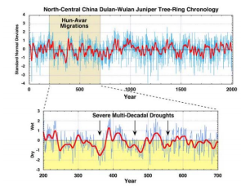
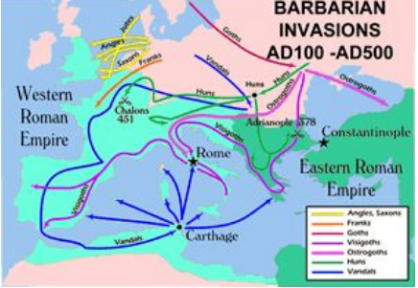
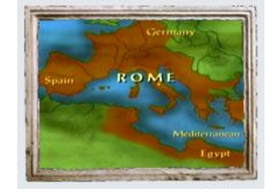
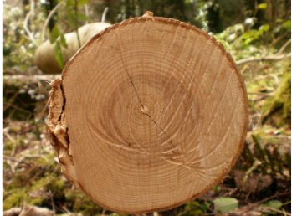
SCIENTIFIC FACTORS OF HOW CLIMATE INSTABILITY SERVED AS A CATALYST TO THE COLLAPSE AND FALL OF ROME AND THE WESTERN ROMAN EMPIRE Department of ESPE and Classics Published by Patrice Richard
Methods
Scientific evidence can provide context within cultures and environments that can construct a story about how people react to their environment. Tree rings are able to tell the observer the amount of precipitation in a region and can serve as evidence for droughts. Speleothem records coincide with regional cultural breakdowns and possibly with climatic events. The diet of ancient people can give insights into human societies and individuals in terms of their social and economic structure, health status and standards of living. Scientific evidence provides us with new insights into the fate of the Western Roman Empire.
Introduction
In the last few centuries, two influential superpowers, the United States and Great Britain, have been revolutionized and transformed by the Industrial Revolution. Since this shift of production in the 1800s, a vast amount of carbon dioxide, a greenhouse gas, has built up and altered the Earth’s atmosphere. This has raised global temperatures by 1.4° Fahrenheit since the 1880s. This is the first time humans are directly responsible for altering the atmosphere. Climate scientists use clues from preserved ice cores to preserved tree rings to reconstruct the environment of a specific location and specific time. Today’s world superpowers need to reflect on how climate instability ultimately served as a catalyst of the fall of Rome and the Western Roman Empire so they do not share the same fate.
Conclusion
At its peak, the Western Roman Empire controlled much of Europe, Asia Minor, North Africa and the Mediterranean Sea, a very vast region. It operated strong trade networks, had a flourishing economy, and a mighty army. Internal problems such as political turmoil and economic stress weakened the empire. External problems such as invasions from the East sped up or served as a catalyst for the fall of Rome and the Western Roman Empire. These invasions were ultimately caused by mega-droughts in Central Asia.
The Dulan-Wulan annual tree-ring chronology from north-central China displays the correlation between severe multi-decadal mega droughts and Hun-Avar migrations (Cook 2013).
Tree rings can tell us how old the tree is and what the weather was like during each year of the tree’s life.
Discussion
Like the Western Roman Empire, the nomadic Huns faced a combination of political turmoil and environmental crises. These environmental crises led the Huns to migrate towards places where there were sufficient natural resources, which happened to be in Western Europe. Data from ancient tree rings from Central-North Asia suggests that three mega-droughts struck Central Asia between 360 CE and 550 CE (Cook 2013).
Today, scientists are using the El Niño Southern Oscillation (ENSO) as the most important mode of internal climate variability on earth (Cook 2013). By looking at how ENSO can influence precipitation and drought over Central Asia today we can use modern day precipitation and drought records to create a similar model of precipitation in Central Asia in the time period of the Late Roman Empire. The data shows that there is a connection between the El Niño Southern Oscillation and precipitation over north-central China and Central Asia, the Huns’ dwelling. The El Niño Southern Oscillation could have played a role in the mega-droughts of the fourth-sixth centuries CE that encouragesd the Hun and Avar migrations (Cook 2013).
Archaeobotanical research of charred plant remains from the settlement of La Fontanaccia, Allumiere, 50 km northwest of Rome, indicates the effects of the Germanic invasions on everyday Roman life (Sadori and Susanna 2005). The most common food seeds found were the Lathyrus sativus, or grass pea, a low quality food typically used to feed livestock. This study suggests that central Italy suffered from a general state of economic and agricultural regression in the late Roman Empire.
Between 100 A.D. to 500 A.D. the Western Roman Empire came under attack by different groups such as the Franks, Goths, Ostrogoths and Visigoths, who were forced by the Huns migrating from Central Asia to seek refuge and better resources in the Western Roman Empire.
The Roman Empire, ruled from Rome, was a unified political system, an empire, which extended from what is now England to what is now Africa and from what is now Syria to what is now Spain. At its peak, one in every four people on Earth lived and died under Roman Law and the empire was twenty percent of the world’s population (PBS 2019).
References
Büntgen, Ulf, et al. “2500 Years of European Climate Variability and Human Susceptibility.” ​Science​, 4 Feb. 2011, science.sciencemag.org/content/331/6017/578.full
Cook, Edward R. “Megadroughts, ENSO, and the Invasion of Late-Roman Europe by the Huns and Avars,” in The Ancient Mediterranean Environment between Science and History​, ed. W.V. Harris (Brill 2013)
Drake, B. Lee. “Changes in North Atlantic Oscillation Drove Population Migrations and the Collapse of the Western Roman Empire.” ​Nature News​, Nature Publishing Group, 27 Apr. 2017, www.nature.com/articles/s41598-017-01289-z.
Enloe. “North Atlantic Oscillation (NAO).” ​National Climatic Data Center​, www.ncdc.noaa.gov/teleconnections/nao/
McCormick, Michael et al., “Climate Change during and after the Roman Empire: Reconstructing the Past from Scientific and Historical Evidence - Semantic Scholar.” Journal of Interdisciplinary History​ 2011.
PBS“The Roman Empire: in the First Century. The Roman Empire, Public Broadcasting Service, https://www.pbs.org/empires/romans/empire/.
Psomiadis D. et al. “Speleothem Record of Climatic Changes in the Northern Aegean Region (Greece) from the Bronze Age to the Collapse of the Roman Empire.” Palaeogeography, Palaeoclimatology, Palaeoecology,, 25 Oct. 2017, www.sciencedirect.com/science/article/pii/S0031018217307629
Sadori, Laura, and Susanna, Francesca. “Hints of Economic Change during the Late Roman Empire Period in Central Italy: a Study of Charred Plant Remains from ‘La Fontaccia’, near Rome.” ​Vegetation History and Archaeobotany 2005, 386-393.
Background
The Western Roman Empire was a colossal superpower by size and political influence and serves today as a foundation in contemporary politics, government, law, art and architecture. As massive as it was, this empire eventually crumbled and fell, which has baffled historians and scientists. Internally, the empire was facing conflicts such as political corruption, inflation, military and urban decay due to poor leadership from its emperors. Externally, the Western Roman Empire faced threats from its neighbors, including from different Germanic groups due to climate instability in Central Asia. When a mega-drought developed in Central Asia, the Huns began moving west in search of food and other resources needed to survive (Cook 2013). While traveling West they forced the Germanic tribes to break through the borders of the Western Roman Empire with their large numbers destroying crops and infrastructure along the way. This was the last push for the Western Roman Empire which eventually crumbled in light of these invasions caused by climate instability in the East.

